Slide 1


ngParty - Regular meetup XXIV
React app
#webperf tuning
Pavel Gavlík
Product Engineer
February 2019

Slide 2

ngParty - Regular meetup XXIV
React app
#webperf tuning
Pavel Gavlík
Product Engineer
February 2019

Slide 3
How the BBC builds websites that scale The BBC found they lost an additional 10% of users for every additional second their site took to load.
Page weight matters After optimization Youtube became usable for people from Southeast Asia, South America, Africa, and even remote regions of Siberia
Merlon Intelligence story Global expansion wouldn’t be possible without reducing page size
Why optimize web performance?
It affects both business metrics & UX
ngParty - Regular meetup XXIV
February 2019

Slide 4
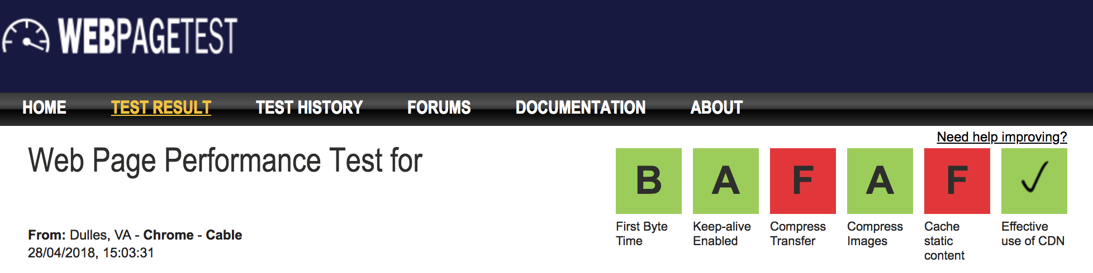
Start With the Obvious
Enable Gzip compression
ngParty - Regular meetup XXIV
February 2019

Slide 5
4X Smaller Static Assets
Up to 3X Faster Page Load
Start With the Obvious
Enable Gzip compression - Results
ngParty - Regular meetup XXIV
February 2019

Slide 6
ngParty - Regular meetup XXIV
Demo
Source-map-explorer
February 2019

Slide 7
3.3M main.195b8edd.js
2.5M main.080ecae7.js
9.2K 4.db886c53.chunk.js
11K 5.a767b89a.chunk.js
3.0K 6.316244b4.chunk.js
2.0K 7.3ab990b1.chunk.js
12K 8.6bc666cf.chunk.js
251K 9.dfb2c210.chunk.js
...
Load Only What is Necessary
Code splitting and async loading (-0.82M)
ngParty - Regular meetup XXIV
February 2019

Slide 8
graphql-document-collector has a straightforward CLI interface to precompile all of your GraphQL documents in one definition file.
Problem of One Huge File
graphql-document-collector
ngParty - Regular meetup XXIV
February 2019

Slide 9
graphql-document-collector has a straightforward CLI interface to precompile all of your GraphQL documents in one definition file.
documents.json • 643.07 KB (makes it hard to use code splitting)
Problem of One Huge File
graphql-document-collector
ngParty - Regular meetup XXIV
February 2019

Slide 10
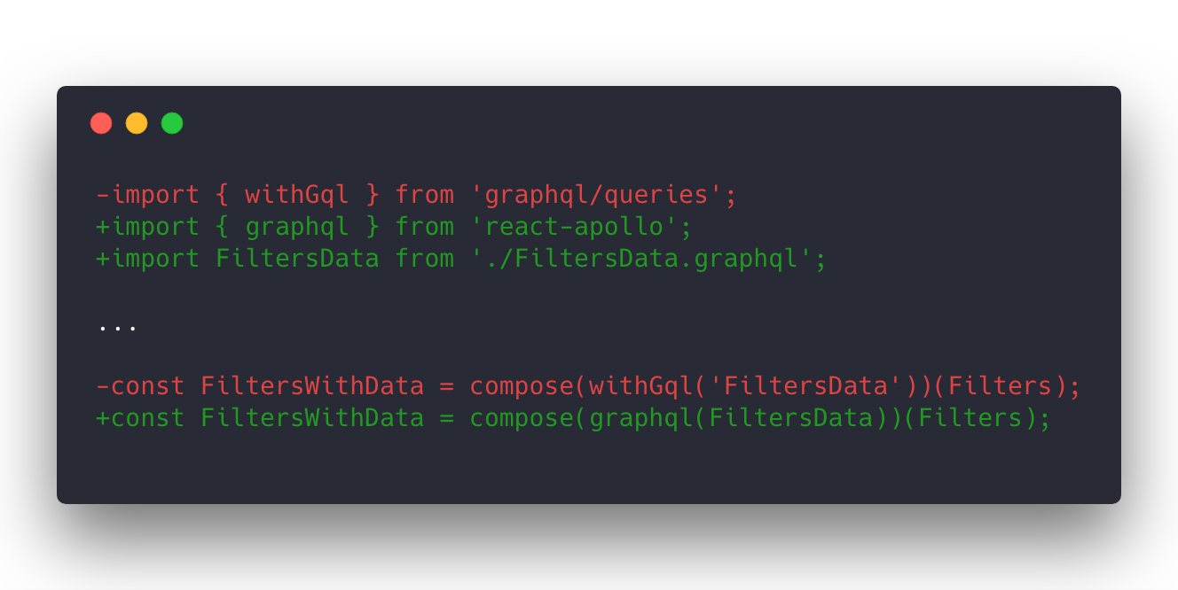
Problem of One Huge File
graphql-document-collector → gql imports (-0.61M)
ngParty - Regular meetup XXIV
February 2019

Slide 11
react-datepicker (122K including moment dependency)
ion-range slider (41K + 87K jquery dependency)
common (61K including ramda)
Clean Your Code Regularly
Remove unused packages (-0.32M)
ngParty - Regular meetup XXIV
February 2019

Slide 12
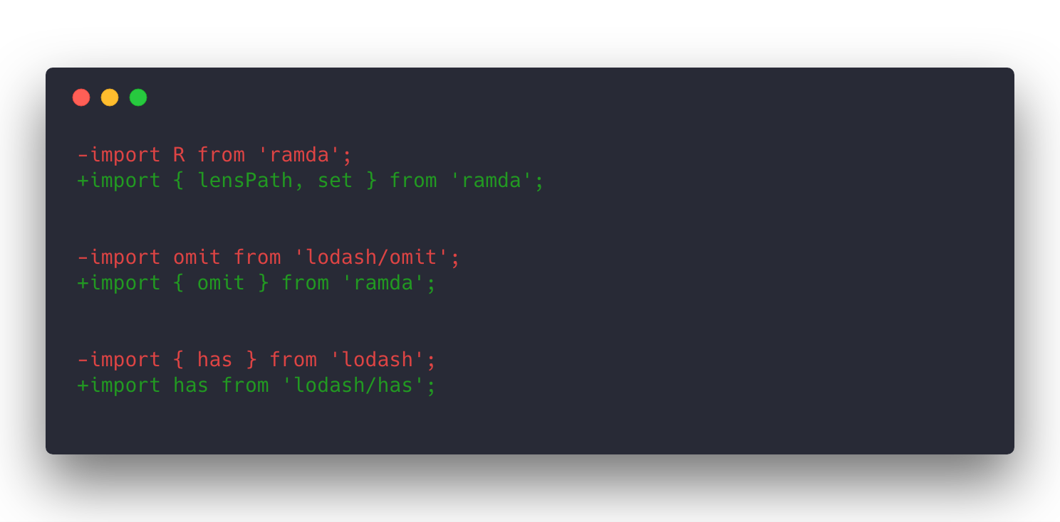
Use Build System, But Check Its Output
Optimized imports (-0.12M)
ngParty - Regular meetup XXIV
February 2019

Slide 13
Optimize & inline SVG logo
https://github.com/jakearchibald/svgomg
Preloading fonts
not very noticeable impact
Warm up GraphQL client cache
prefetching of query in critical path
Other Work
ngParty - Regular meetup XXIV
February 2019

Slide 14
ngParty - Regular meetup XXIV
Demo
Source-map-explorer
(after webperf optimizations)
February 2019

Slide 15
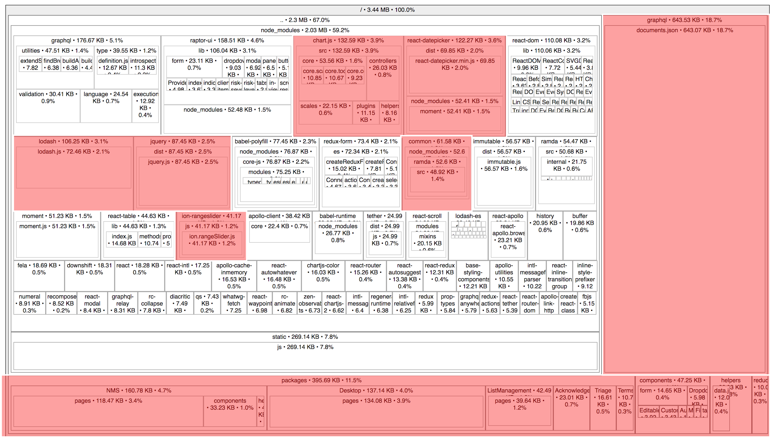

Slide 16
3.44M → 1.58M
2x Smaller Main Bundle
4x Smaller Using Gzip
Final Results
ngParty - Regular meetup XXIV
February 2019

Slide 17
3.44M → 1.58M
2x Smaller Main Bundle
4x Smaller Using Gzip
Final Results
ngParty - Regular meetup XXIV
February 2019

Slide 18
3.44M → 1.58M
2x Smaller Main Bundle
4x Smaller Using Gzip
Final Results
ngParty - Regular meetup XXIV
February 2019

Slide 19
Bundlesize to keep bundle size within budget
HTTP/2 / Brotli compression
React → Preact
Remove graphql package (Is it necessary for apollo-client?)
What Could Work in the Future?
ngParty - Regular meetup XXIV
February 2019

Slide 20
Learn more from experts:
Ilya Grigorik, Tim Kadlec, #webperf
Don’t guess, measure!
ngParty - Regular meetup XXIV
Next Steps
Pavel Gavlík
Product Engineer
February 2019

